Slide 1
Elastic Search and Indexing
Name::: Sunil and Team
Date::: 03-11-2022

Slide 2
Agenda
Problem Statement and it’s Complexity
What is Elastic Search?
Components in ES
BM25 – Uniqueness
Architecture
Teck Stack and Development Tools
Demo
Challenges
References
Elastic Search and Indexing

Slide 3
Problem Statement and it’s Complexity
The actual problem arrives while searching in large databases. For example, if we have employee table and we want to find the name of an employee by employee id, we need to run an SQL query in database which internally searches each record with the given employee id to get the result. This takes more time to search.

Slide 4
What is Elastic Search?
Elasticsearch is a distributed, open-source search and analytics engine built on Apache Lucene and developed in Java.
Elasticsearch allows you to store, search, and analyze huge volumes of data quickly and in near real-time and give back results in milliseconds.
It’s able to achieve fast search responses because instead of searching the text directly, it searches an index.
It uses a structure based on documents instead of tables and schemas and comes with extensive REST APIs for storing and searching the data.

Slide 5
Components in ES
Logical Components:
Documents
Indices
Backend Components:
Shards
Replicas

Slide 6
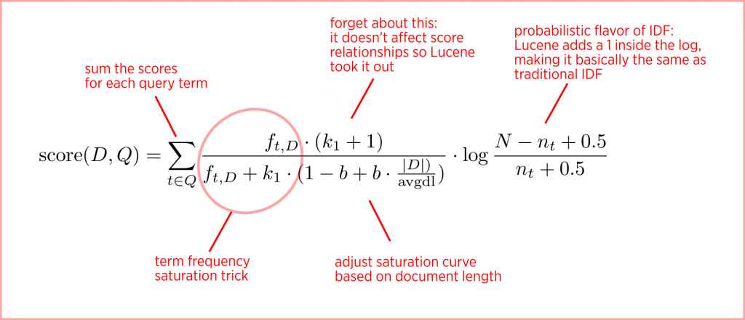
BM25

Slide 7
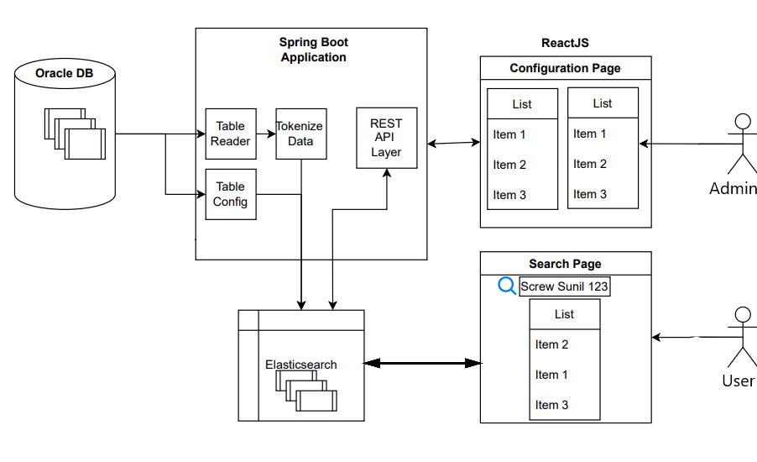
Architecture

Slide 8
Tech Stack and Development Tools
Tech Stack
React with TypeScript
ElasticSearch
Springboot
Development Tools
Eclipse IDE
Visual Studio Code
MySQL Database

Slide 9
Challenges
Understanding Problem Statement
Installations
Integrating BM25 with Elastic Search by using Springboot
Integrating frontend with backend
Double column transfer choice box.

Slide 10
References
Spring Boot:
https://www.youtube.com/playlist?list=PL0zysOflRCelmjxj-g4jLr3WKraSU_e8q
https://www.linkedin.com/learning/spring-boot-2-0-essential-training-2/commandlinerunner-interface?autoplay=true&u=91360026
Elastic Search:
https://www.linkedin.com/learning/elasticsearch-essential-training/welcome?autoplay=true&u=91360026
React with TypeScript:
https://www.linkedin.com/learning/react-using-typescript?u=91360026

Slide 11
DEMO

Slide 12
Thank You

